Slide 1
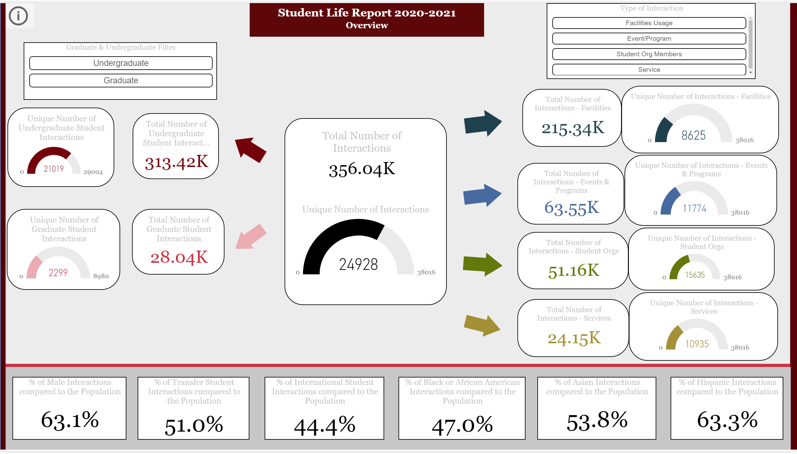
Overview
Notes:
card
No alt text provided.
Total Number of Interactions
No alt text provided.
card
No alt text provided.
Total Number of Undergraduate Student Interactions
No alt text provided.
Unique Number of Interactions
No alt text provided.
card
No alt text provided.
textbox
No alt text provided.
Unique Number of Undergraduate Student Interactions
No alt text provided.
Unique Number of Graduate Student Interactions
No alt text provided.
Total Number of Graduate Student Interactions
No alt text provided.
% of Male Interactions compared to the Population
No alt text provided.
% of Transfer Student Interactions compared to the Population
No alt text provided.
% of International Student Interactions compared to the Population
No alt text provided.
% of Hispanic Interactions compared to the Population
No alt text provided.
% of Asian Interactions compared to the Population
No alt text provided.
% of Black or African American Interactions compared to the Population
No alt text provided.
basicShape
No alt text provided.
basicShape
No alt text provided.
actionButton
No alt text provided.
basicShape
No alt text provided.
basicShape
No alt text provided.
basicShape
No alt text provided.
Total Number of Interactions - Facilities
No alt text provided.
Unique Number of Interactions - Facilities
No alt text provided.
actionButton
No alt text provided.
actionButton
No alt text provided.
image
No alt text provided.
textbox
No alt text provided.
textbox
No alt text provided.
textbox
No alt text provided.
textbox
No alt text provided.
textbox
No alt text provided.
textbox
No alt text provided.
image
No alt text provided.
image
No alt text provided.
image
No alt text provided.
image
No alt text provided.
basicShape
No alt text provided.
basicShape
No alt text provided.
Type of Interaction
No alt text provided.
Total Number of Interactions - Services
No alt text provided.
Unique Number of Interactions - Services
No alt text provided.
Total Number of Interactions - Student Orgs
No alt text provided.
Graduate & Undergraduate Filter
No alt text provided.
Unique Number of Interactions - Student Orgs
No alt text provided.
Total Number of Interactions - Events & Programs
No alt text provided.
Unique Number of Interactions - Events & Programs
No alt text provided.

Slide 2
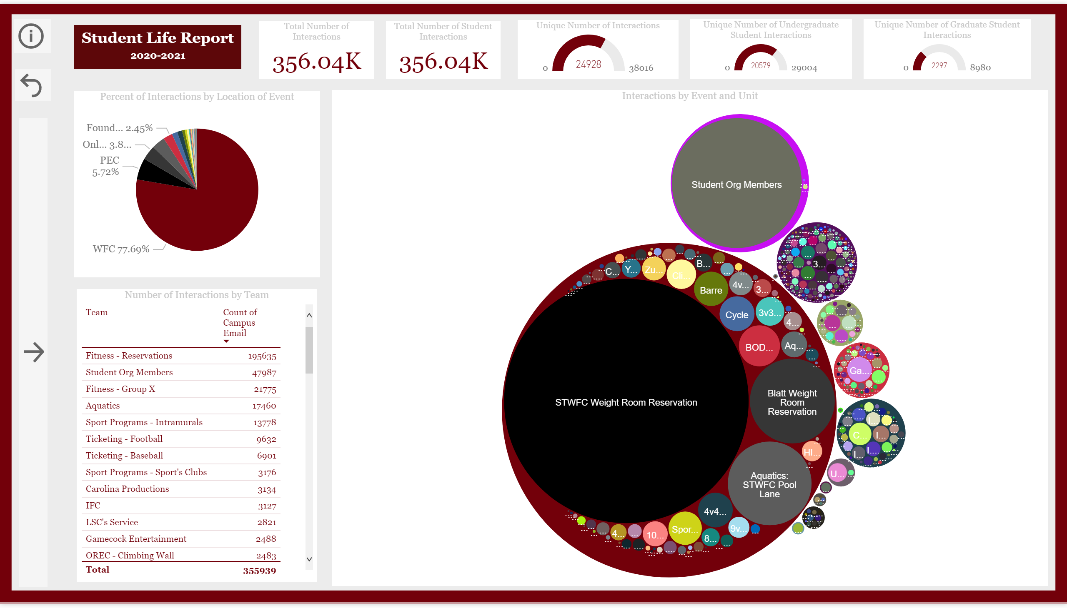
General Statistics
Notes:
textbox
No alt text provided.
Clear Filters Button
No alt text provided.
actionButton
No alt text provided.
textbox
No alt text provided.
ChicletSlicer1448559807354
No alt text provided.
ChicletSlicer1448559807354
No alt text provided.
ChicletSlicer1448559807354
No alt text provided.
ChicletSlicer1448559807354
No alt text provided.
actionButton
No alt text provided.
Open Panel Button
No alt text provided.
actionButton
No alt text provided.
Info Button
No alt text provided.
textbox
No alt text provided.
image
No alt text provided.
textbox
No alt text provided.
image
No alt text provided.
textbox
No alt text provided.
Unique Number of Interactions
No alt text provided.
Total Number of Interactions
No alt text provided.
Total Number of Student Interactions
No alt text provided.
Unique Number of Graduate Student Interactions
No alt text provided.
Unique Number of Undergraduate Student Interactions
No alt text provided.
Interactions by Event and Unit
No alt text provided.
Number of Interactions by Team
No alt text provided.
Percent of Interactions by Location of Event
No alt text provided.
image
No alt text provided.
textbox
No alt text provided.
ChicletSlicer1448559807354
No alt text provided.
actionButton
No alt text provided.

Slide 3
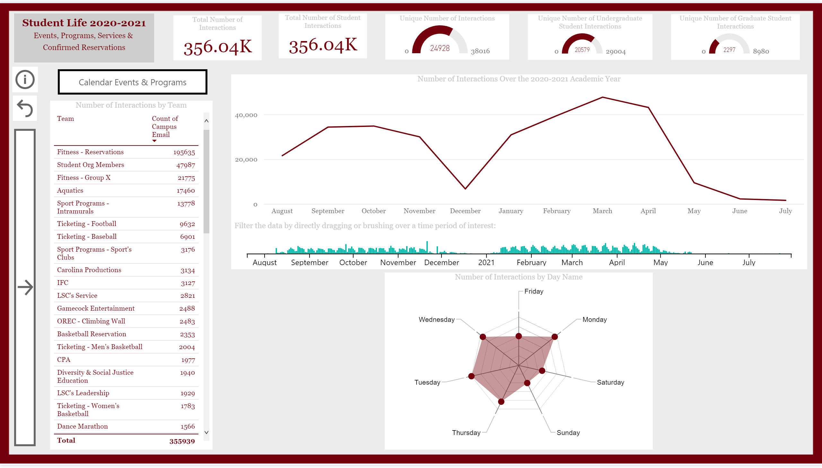
Time Trends
Notes:
actionButton
No alt text provided.
actionButton
No alt text provided.
actionButton
No alt text provided.
actionButton
No alt text provided.
actionButton
No alt text provided.
calendarVisual74934D05B71F4C31B0F79D925EE89638
No alt text provided.
hundredPercentStackedBarChart
No alt text provided.
actionButton
No alt text provided.
image
No alt text provided.
image
No alt text provided.
image
No alt text provided.
image
No alt text provided.
image
No alt text provided.
textbox
No alt text provided.
textbox
No alt text provided.
textbox
No alt text provided.
textbox
No alt text provided.
textbox
No alt text provided.
actionButton
No alt text provided.
textbox
No alt text provided.
actionButton
No alt text provided.
actionButton
No alt text provided.
ChicletSlicer1448559807354
No alt text provided.
ChicletSlicer1448559807354
No alt text provided.
ChicletSlicer1448559807354
No alt text provided.
ChicletSlicer1448559807354
No alt text provided.
ChicletSlicer1448559807354
No alt text provided.
actionButton
No alt text provided.
textbox
No alt text provided.
Unique Number of Interactions
No alt text provided.
Total Number of Interactions
No alt text provided.
Total Number of Student Interactions
No alt text provided.
Unique Number of Graduate Student Interactions
No alt text provided.
Unique Number of Undergraduate Student Interactions
No alt text provided.
Filter the data by directly dragging or brushing over a time period of interest:
No alt text provided.
Number of Interactions by Day Name
No alt text provided.
Number of Interactions by Team
No alt text provided.
Number of Interactions Over the 2020-2021 Academic Year
No alt text provided.

Slide 4
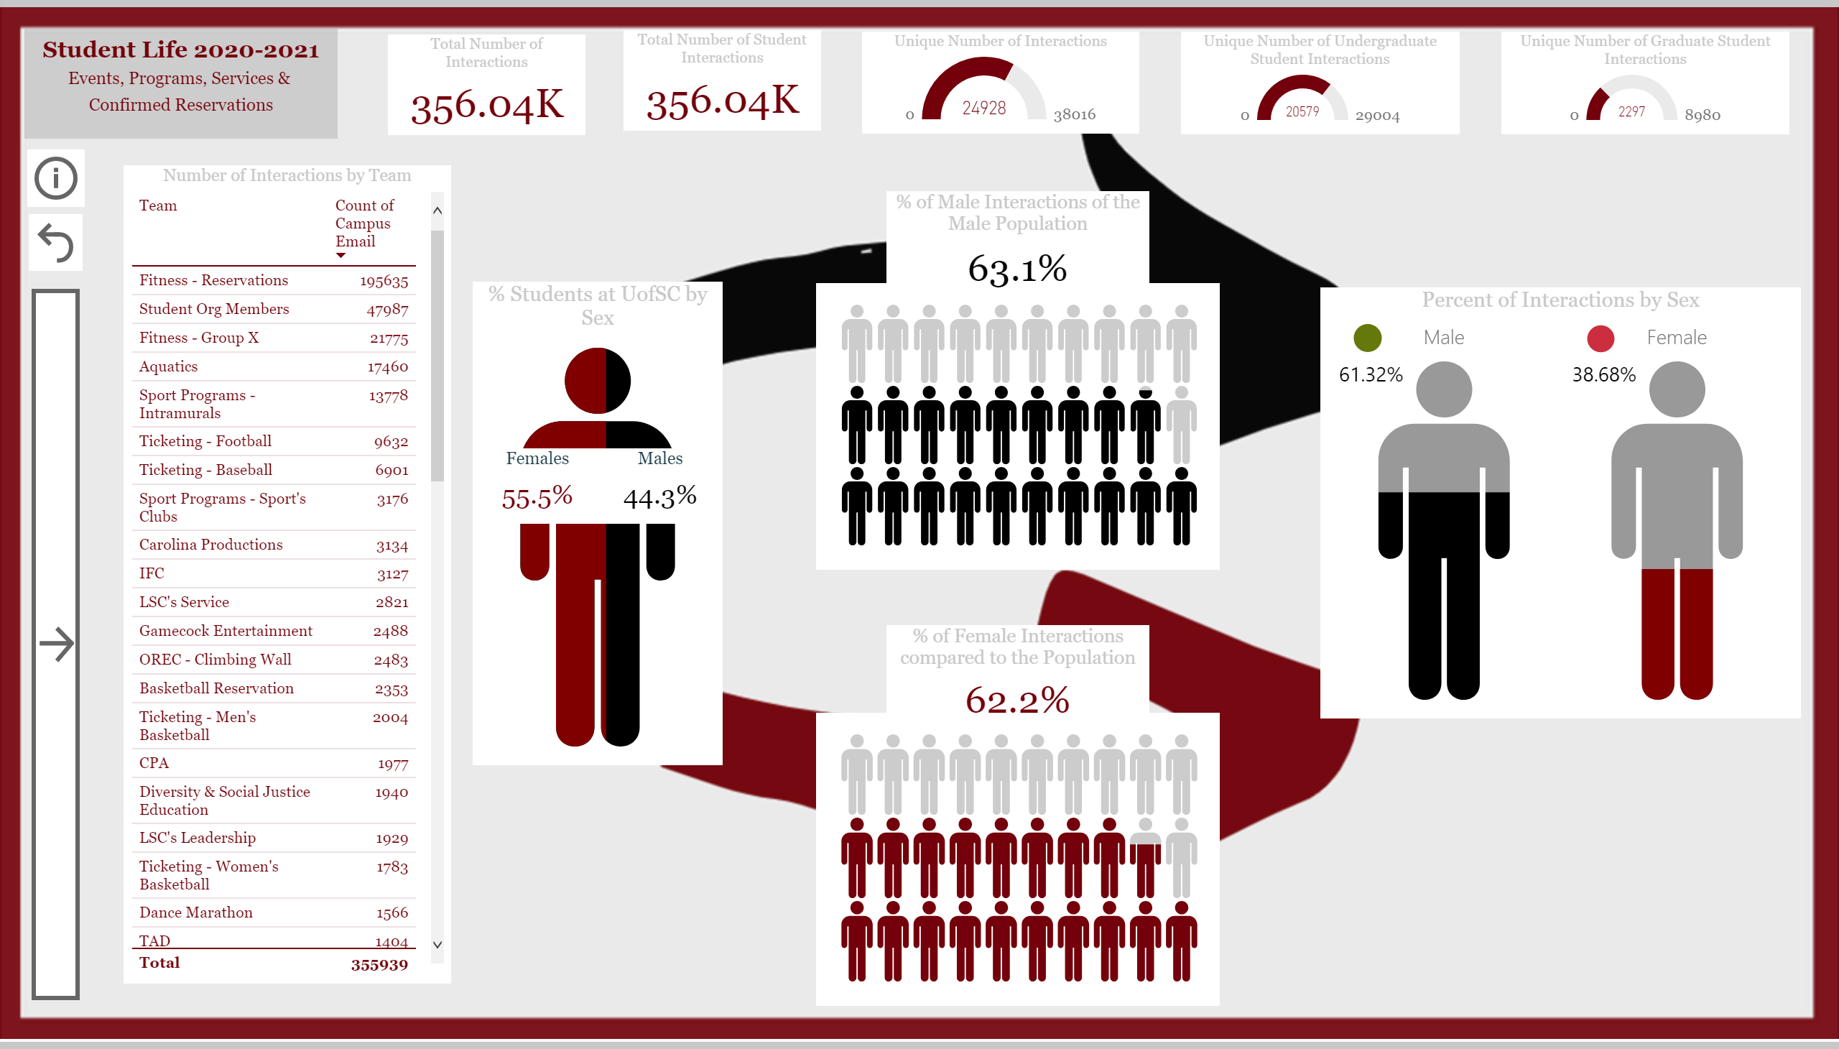
Sex
Notes:
textbox
No alt text provided.
actionButton
No alt text provided.
image
No alt text provided.
image
No alt text provided.
image
No alt text provided.
image
No alt text provided.
image
No alt text provided.
textbox
No alt text provided.
textbox
No alt text provided.
textbox
No alt text provided.
textbox
No alt text provided.
textbox
No alt text provided.
actionButton
No alt text provided.
actionButton
No alt text provided.
textbox
No alt text provided.
actionButton
No alt text provided.
actionButton
No alt text provided.
ChicletSlicer1448559807354
No alt text provided.
ChicletSlicer1448559807354
No alt text provided.
ChicletSlicer1448559807354
No alt text provided.
ChicletSlicer1448559807354
No alt text provided.
ChicletSlicer1448559807354
No alt text provided.
actionButton
No alt text provided.
actionButton
No alt text provided.
actionButton
No alt text provided.
Unique Number of Interactions
No alt text provided.
% of Male Interactions of the Male Population
No alt text provided.
Total Number of Interactions
No alt text provided.
Total Number of Student Interactions
No alt text provided.
Unique Number of Graduate Student Interactions
No alt text provided.
Unique Number of Undergraduate Student Interactions
No alt text provided.
Number of Interactions by Team
No alt text provided.
% Students at UofSC by Sex
No alt text provided.
Percent of Interactions by Sex
No alt text provided.
Females
No alt text provided.
% of Female Interactions compared to the Population
No alt text provided.
Percent of Transfer Students we Interact with at UofSC
No alt text provided.
pieChart
No alt text provided.
pieChart
No alt text provided.
Percent of Transfer Students we Interact with at UofSC
No alt text provided.
Males
No alt text provided.

Slide 5
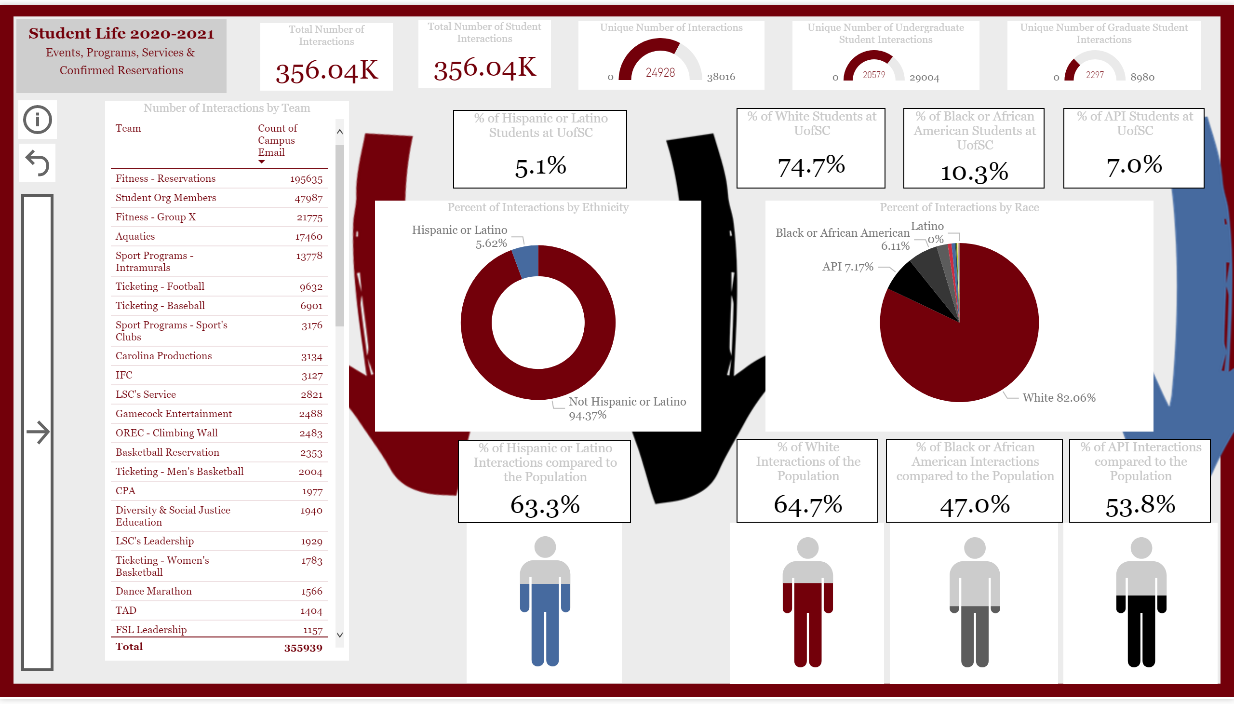
Race & Ethnicity
Notes:
textbox
No alt text provided.
Unique Number of Interactions
No alt text provided.
% of Hispanic or Latino Interactions compared to the Population
No alt text provided.
% of Black or African American Interactions compared to the Population
No alt text provided.
% of API Interactions compared to the Population
No alt text provided.
Total Number of Interactions
No alt text provided.
Total Number of Student Interactions
No alt text provided.
Unique Number of Graduate Student Interactions
No alt text provided.
Unique Number of Undergraduate Student Interactions
No alt text provided.
Number of Interactions by Team
No alt text provided.
Percent of Interactions by Ethnicity
No alt text provided.
% of Hispanic or Latino Students at UofSC
No alt text provided.
Percent of Interactions by Race
No alt text provided.
Percent of Transfer Students we Interact with at UofSC
No alt text provided.
actionButton
No alt text provided.
actionButton
No alt text provided.
actionButton
No alt text provided.
actionButton
No alt text provided.
image
No alt text provided.
textbox
No alt text provided.
image
No alt text provided.
textbox
No alt text provided.
image
No alt text provided.
image
No alt text provided.
textbox
No alt text provided.
textbox
No alt text provided.
image
No alt text provided.
image
No alt text provided.
textbox
No alt text provided.
textbox
No alt text provided.
actionButton
No alt text provided.
actionButton
No alt text provided.
textbox
No alt text provided.
actionButton
No alt text provided.
actionButton
No alt text provided.
ChicletSlicer1448559807354
No alt text provided.
ChicletSlicer1448559807354
No alt text provided.
ChicletSlicer1448559807354
No alt text provided.
ChicletSlicer1448559807354
No alt text provided.
ChicletSlicer1448559807354
No alt text provided.
% of White Students at UofSC
No alt text provided.
Percent of Transfer Students we Interact with at UofSC
No alt text provided.
% of API Students at UofSC
No alt text provided.
Percent of Transfer Students we Interact with at UofSC
No alt text provided.
% of Black or African American Students at UofSC
No alt text provided.
Percent of Transfer Students we Interact with at UofSC
No alt text provided.
% of White Interactions of the Population
No alt text provided.

Slide 6
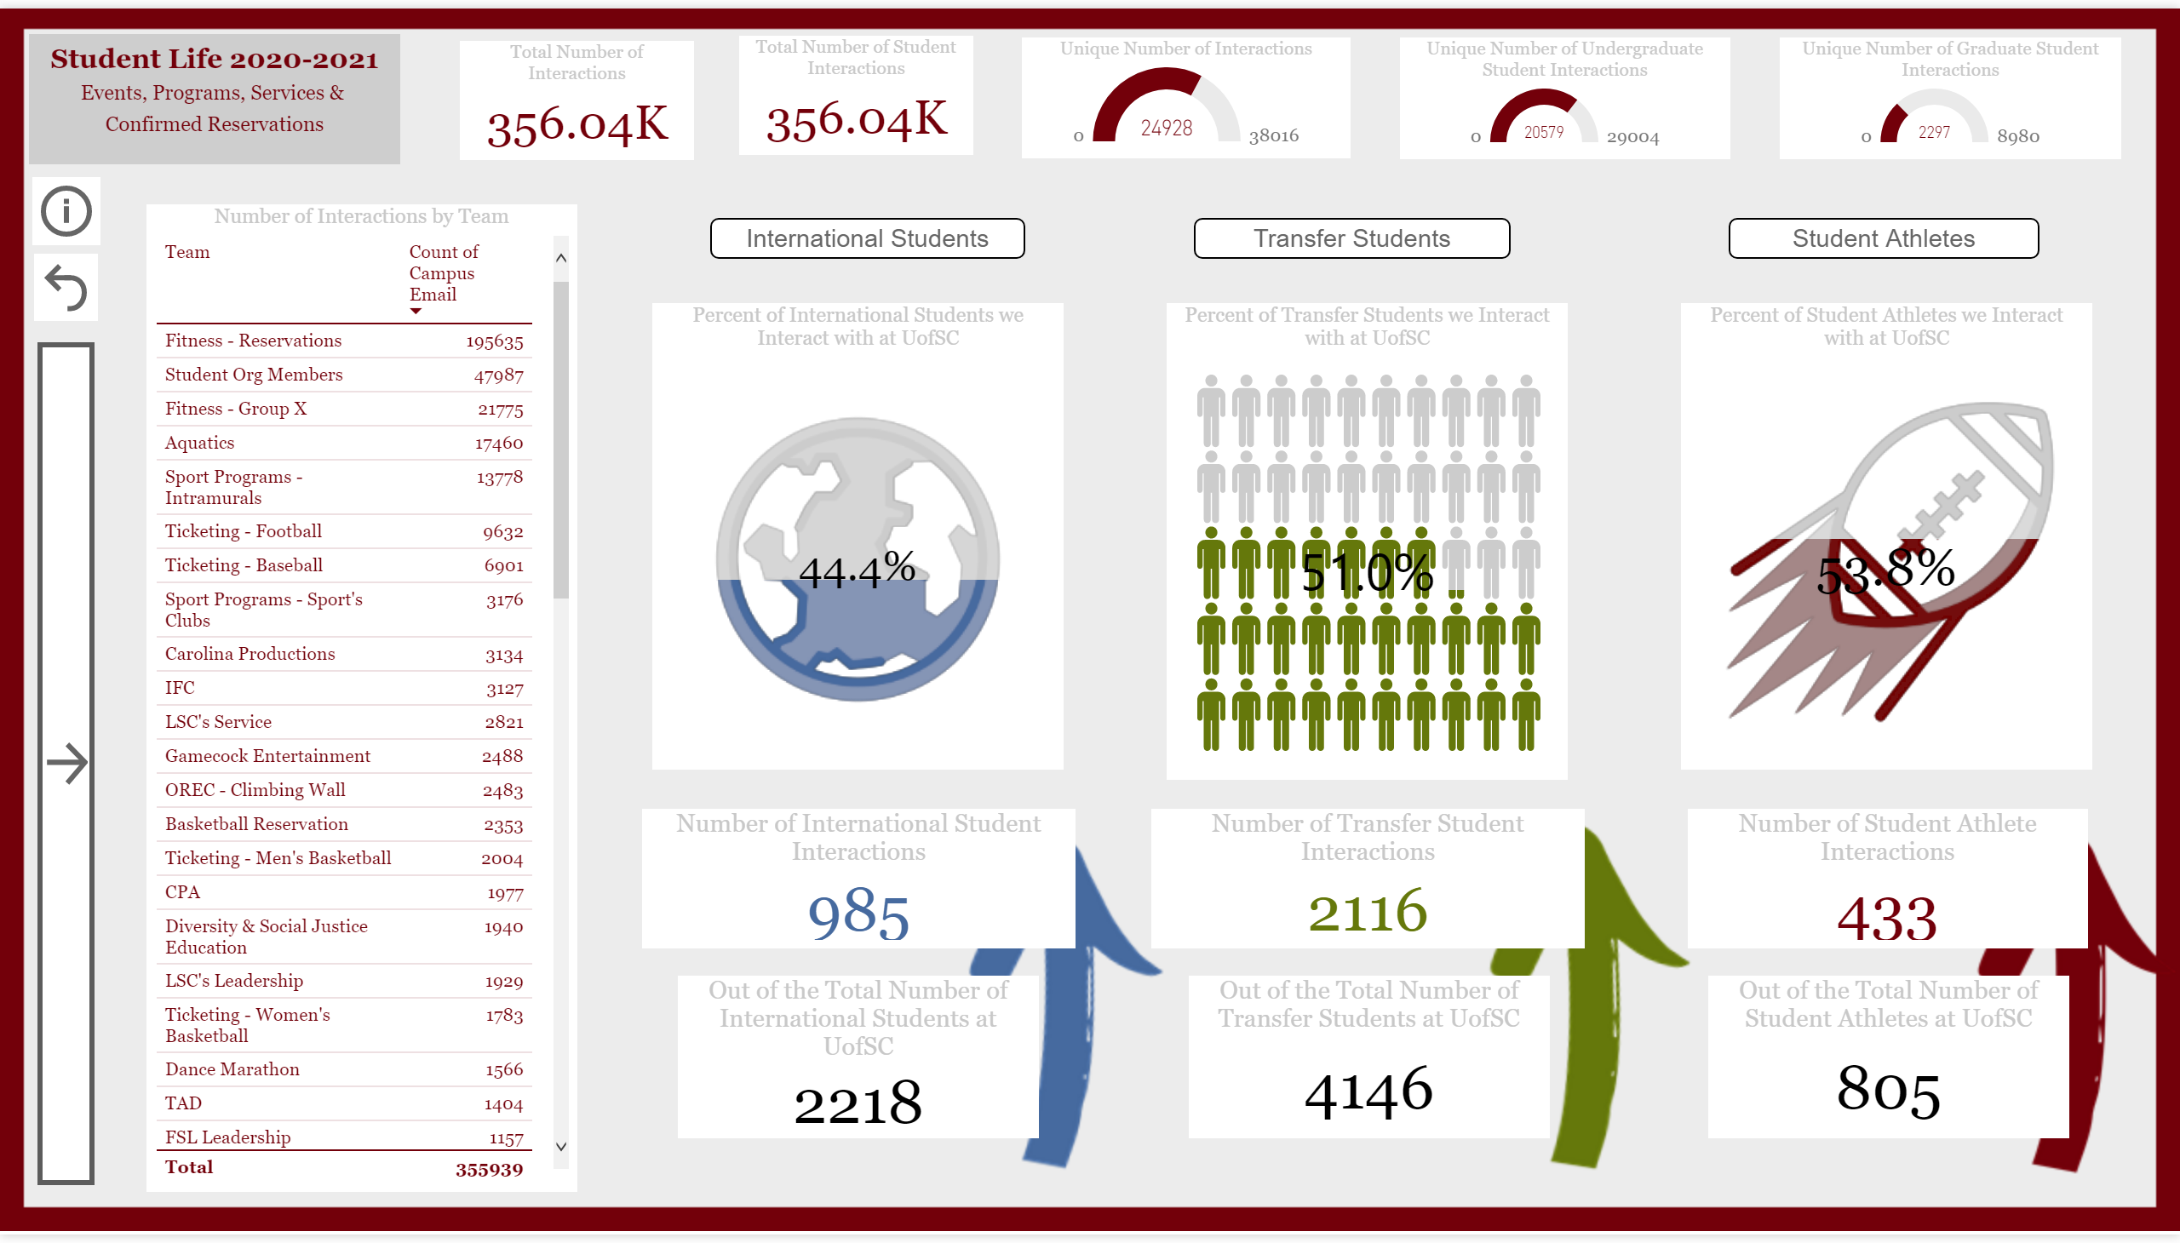
More Demographics
Notes:
Percent of Transfer Students we Interact with at UofSC
No alt text provided.
Percent of Student Athletes we Interact with at UofSC
No alt text provided.
textbox
No alt text provided.
Percent of International Students we Interact with at UofSC
No alt text provided.
actionButton
No alt text provided.
actionButton
No alt text provided.
Type
No alt text provided.
Type
No alt text provided.
Type
No alt text provided.
actionButton
No alt text provided.
actionButton
No alt text provided.
image
No alt text provided.
textbox
No alt text provided.
image
No alt text provided.
textbox
No alt text provided.
image
No alt text provided.
textbox
No alt text provided.
actionButton
No alt text provided.
actionButton
No alt text provided.
textbox
No alt text provided.
actionButton
No alt text provided.
actionButton
No alt text provided.
ChicletSlicer1448559807354
No alt text provided.
ChicletSlicer1448559807354
No alt text provided.
ChicletSlicer1448559807354
No alt text provided.
ChicletSlicer1448559807354
No alt text provided.
ChicletSlicer1448559807354
No alt text provided.
Unique Number of Interactions
No alt text provided.
Total Number of Interactions
No alt text provided.
Total Number of Student Interactions
No alt text provided.
Unique Number of Graduate Student Interactions
No alt text provided.
Unique Number of Undergraduate Student Interactions
No alt text provided.
Number of Interactions by Team
No alt text provided.
Number of International Student Interactions
No alt text provided.
Out of the Total Number of International Students at UofSC
No alt text provided.
Out of the Total Number of Transfer Students at UofSC
No alt text provided.
Out of the Total Number of Student Athletes at UofSC
No alt text provided.
Number of Student Athlete Interactions
No alt text provided.
Number of Transfer Student Interactions
No alt text provided.

Slide 7
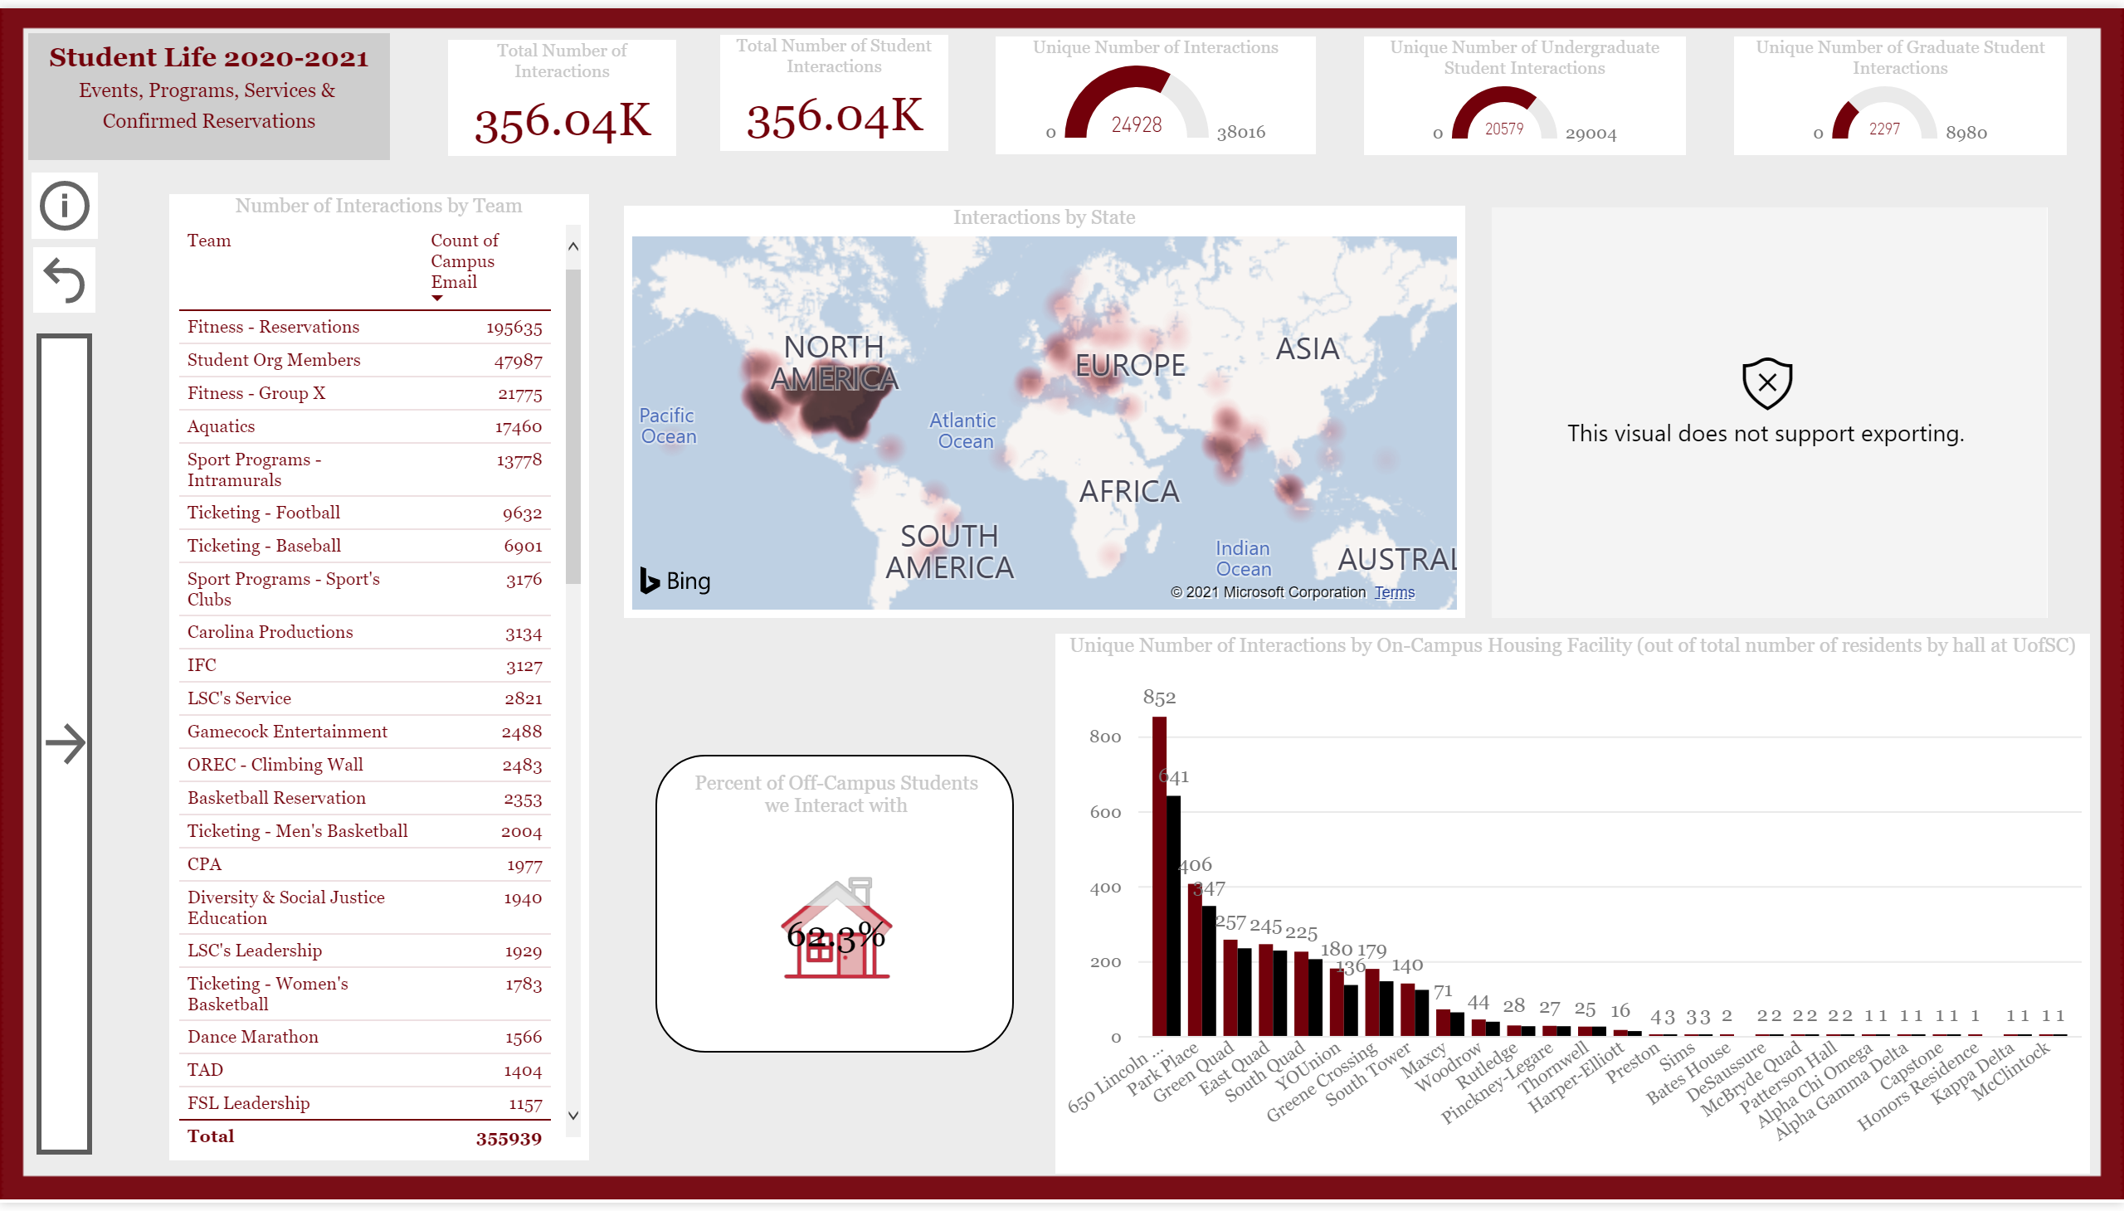
Residence
Notes:
actionButton
No alt text provided.
actionButton
No alt text provided.
actionButton
No alt text provided.
actionButton
No alt text provided.
image
No alt text provided.
image
No alt text provided.
image
No alt text provided.
image
No alt text provided.
textbox
No alt text provided.
textbox
No alt text provided.
textbox
No alt text provided.
textbox
No alt text provided.
actionButton
No alt text provided.
textbox
No alt text provided.
actionButton
No alt text provided.
actionButton
No alt text provided.
ChicletSlicer1448559807354
No alt text provided.
ChicletSlicer1448559807354
No alt text provided.
ChicletSlicer1448559807354
No alt text provided.
ChicletSlicer1448559807354
No alt text provided.
ChicletSlicer1448559807354
No alt text provided.
ChicletSlicer1448559807354
No alt text provided.
textbox
No alt text provided.
Unique Number of Interactions
No alt text provided.
Total Number of Interactions
No alt text provided.
Total Number of Student Interactions
No alt text provided.
Unique Number of Graduate Student Interactions
No alt text provided.
Unique Number of Undergraduate Student Interactions
No alt text provided.
Number of Interactions by Team
No alt text provided.
Unique Number of Interactions by On-Campus Housing Facility (out of total number of residents by hall at UofSC)
No alt text provided.
Countries students are from
No alt text provided.
Percent of Off-Campus Students we Interact with
No alt text provided.
Interactions by State
No alt text provided.

Slide 8
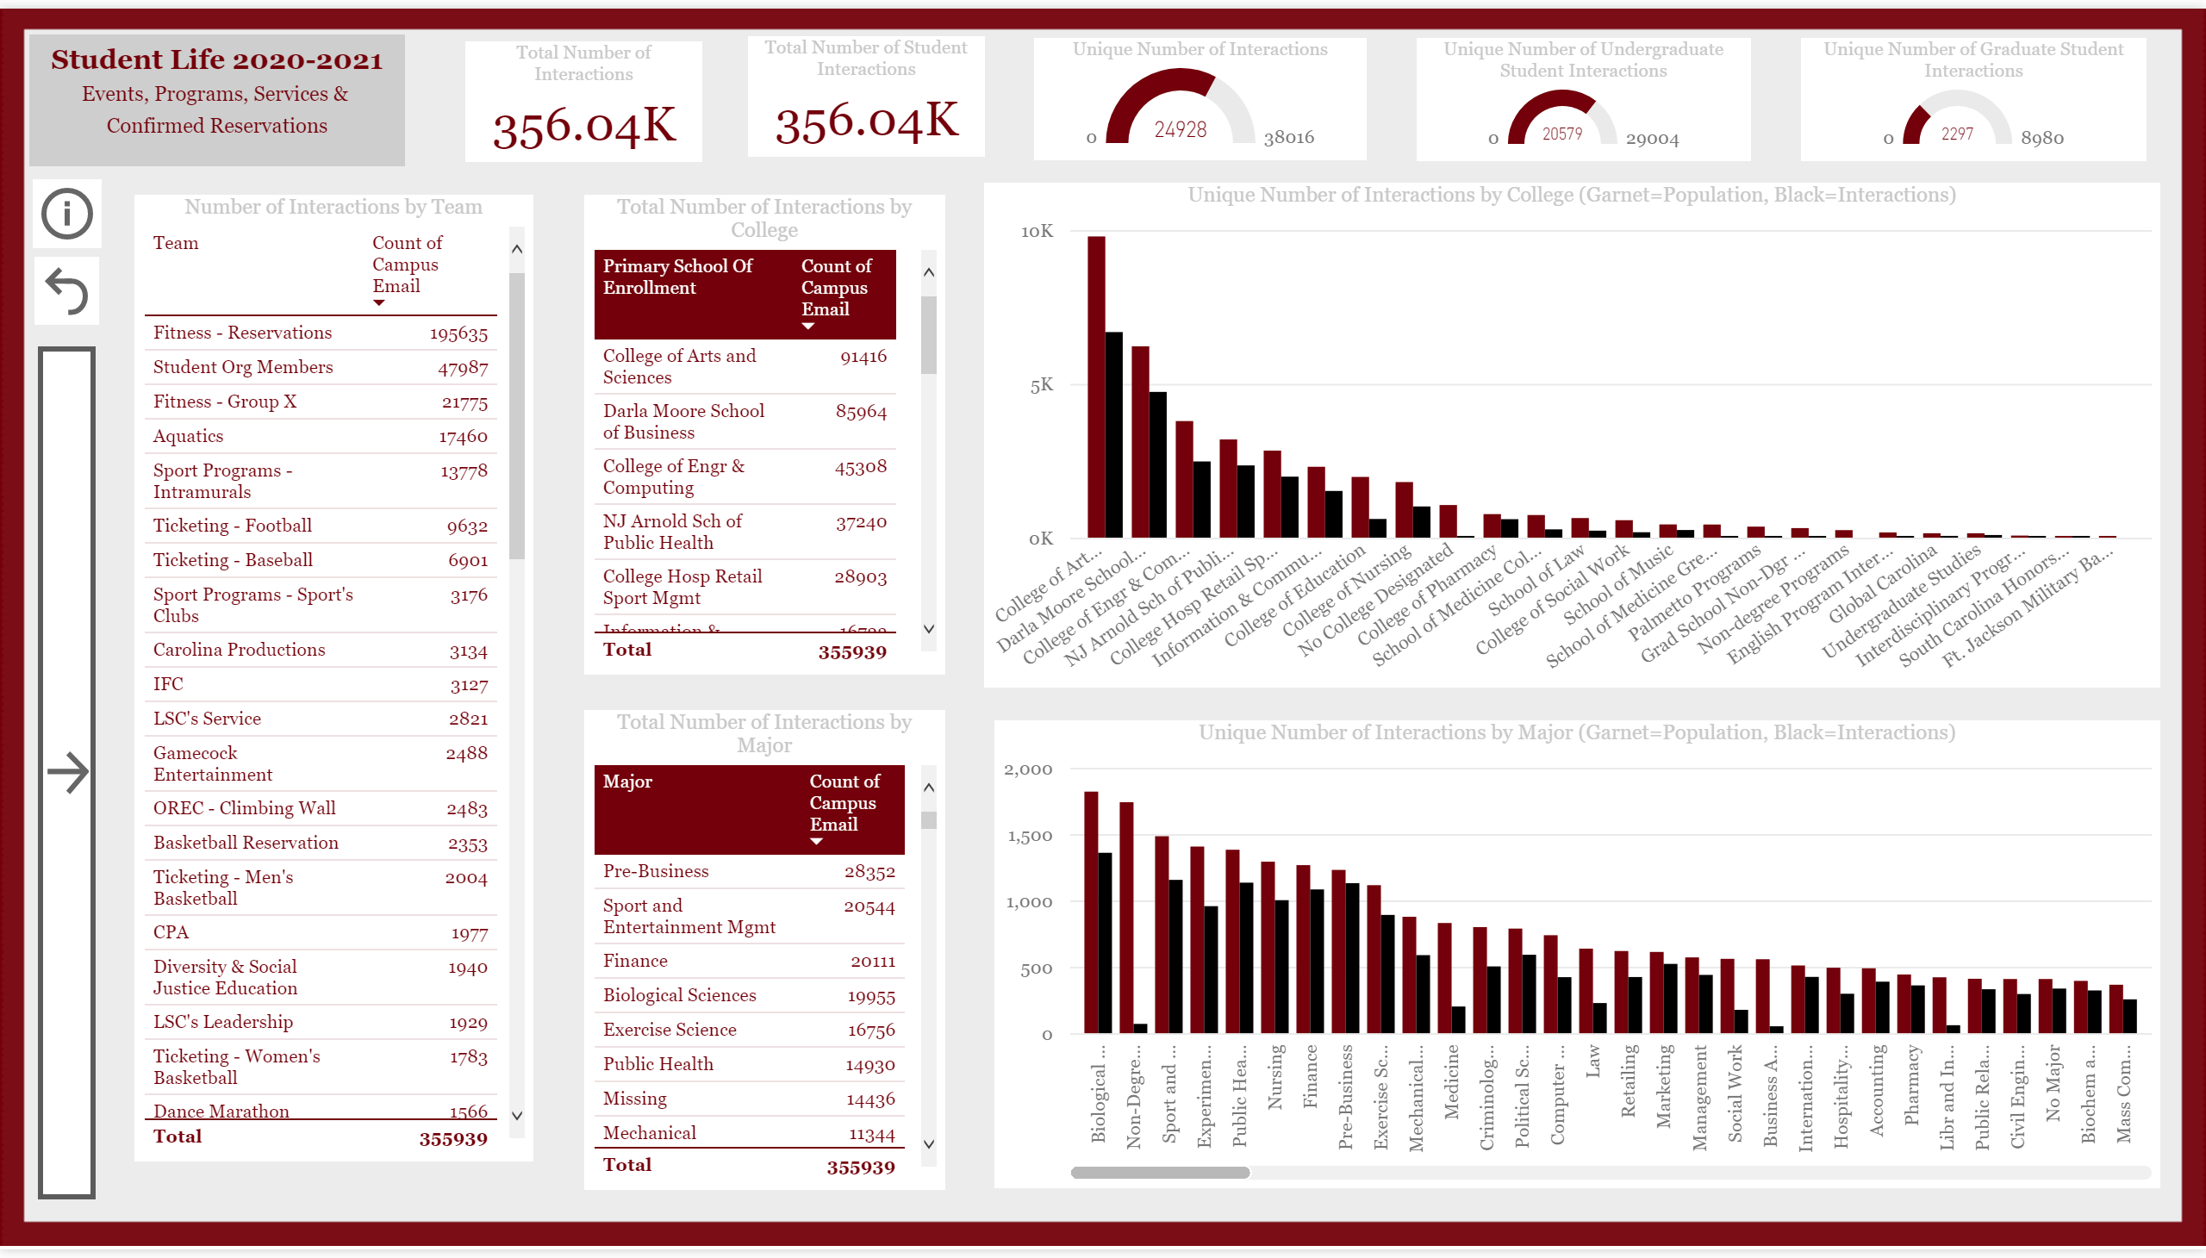
College Statistics
Notes:
textbox
No alt text provided.
actionButton
No alt text provided.
image
No alt text provided.
image
No alt text provided.
textbox
No alt text provided.
textbox
No alt text provided.
actionButton
No alt text provided.
textbox
No alt text provided.
actionButton
No alt text provided.
actionButton
No alt text provided.
ChicletSlicer1448559807354
No alt text provided.
ChicletSlicer1448559807354
No alt text provided.
ChicletSlicer1448559807354
No alt text provided.
ChicletSlicer1448559807354
No alt text provided.
ChicletSlicer1448559807354
No alt text provided.
actionButton
No alt text provided.
actionButton
No alt text provided.
actionButton
No alt text provided.
Unique Number of Interactions
No alt text provided.
Total Number of Interactions
No alt text provided.
Total Number of Student Interactions
No alt text provided.
Unique Number of Graduate Student Interactions
No alt text provided.
Unique Number of Undergraduate Student Interactions
No alt text provided.
Number of Interactions by Team
No alt text provided.
Total Number of Interactions by College
No alt text provided.
Total Number of Interactions by Major
No alt text provided.
Unique Number of Interactions by Major (Garnet=Population, Black=Interactions)
No alt text provided.
Unique Number of Interactions by College (Garnet=Population, Black=Interactions)
No alt text provided.

Slide 9
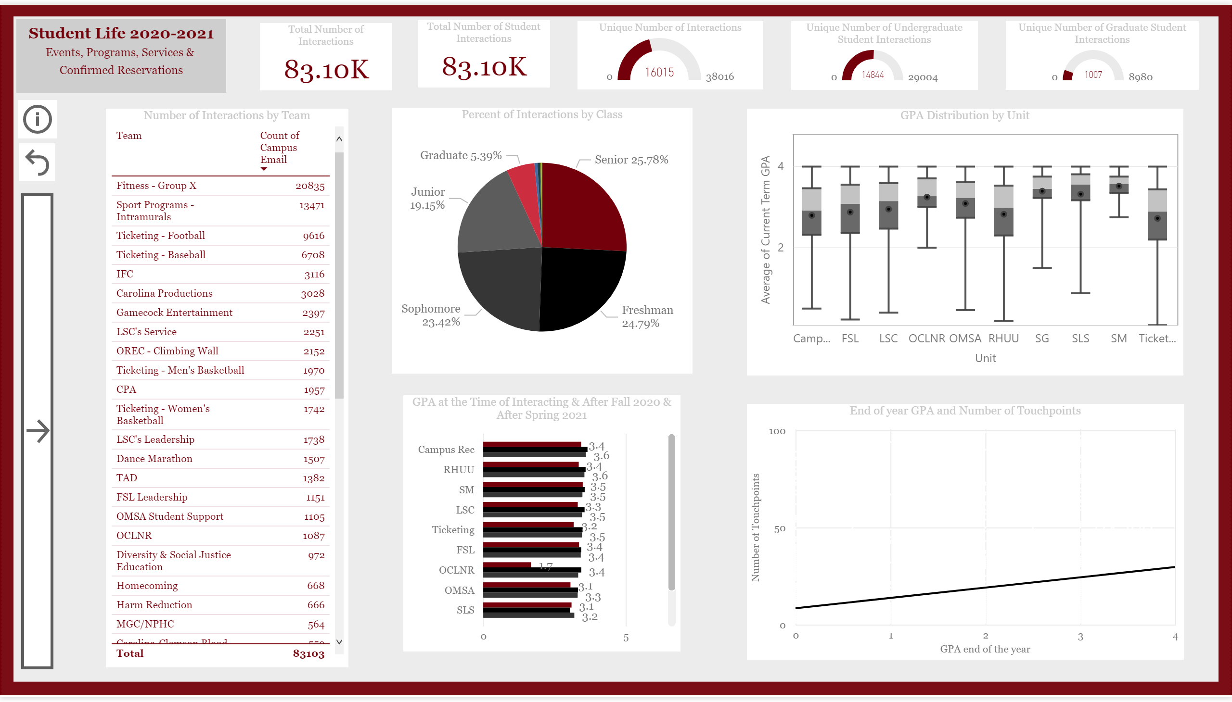
GPA Statistics
Notes:
slicer
No alt text provided.
slicer
No alt text provided.
actionButton
No alt text provided.
image
No alt text provided.
image
No alt text provided.
image
No alt text provided.
image
No alt text provided.
textbox
No alt text provided.
textbox
No alt text provided.
textbox
No alt text provided.
textbox
No alt text provided.
actionButton
No alt text provided.
textbox
No alt text provided.
actionButton
No alt text provided.
actionButton
No alt text provided.
ChicletSlicer1448559807354
No alt text provided.
ChicletSlicer1448559807354
No alt text provided.
ChicletSlicer1448559807354
No alt text provided.
ChicletSlicer1448559807354
No alt text provided.
textbox
No alt text provided.
actionButton
No alt text provided.
actionButton
No alt text provided.
actionButton
No alt text provided.
Total Number of Interactions
No alt text provided.
Total Number of Student Interactions
No alt text provided.
GPA Distribution by Unit
No alt text provided.
Unique Number of Undergraduate Student Interactions
No alt text provided.
Unique Number of Interactions
No alt text provided.
Unique Number of Graduate Student Interactions
No alt text provided.
Number of Interactions by Team
No alt text provided.
GPA at the Time of Interacting & After Fall 2020 & After Spring 2021
No alt text provided.
End of year GPA and Number of Touchpoints
No alt text provided.
Percent of Interactions by Class
No alt text provided.

Slide 10
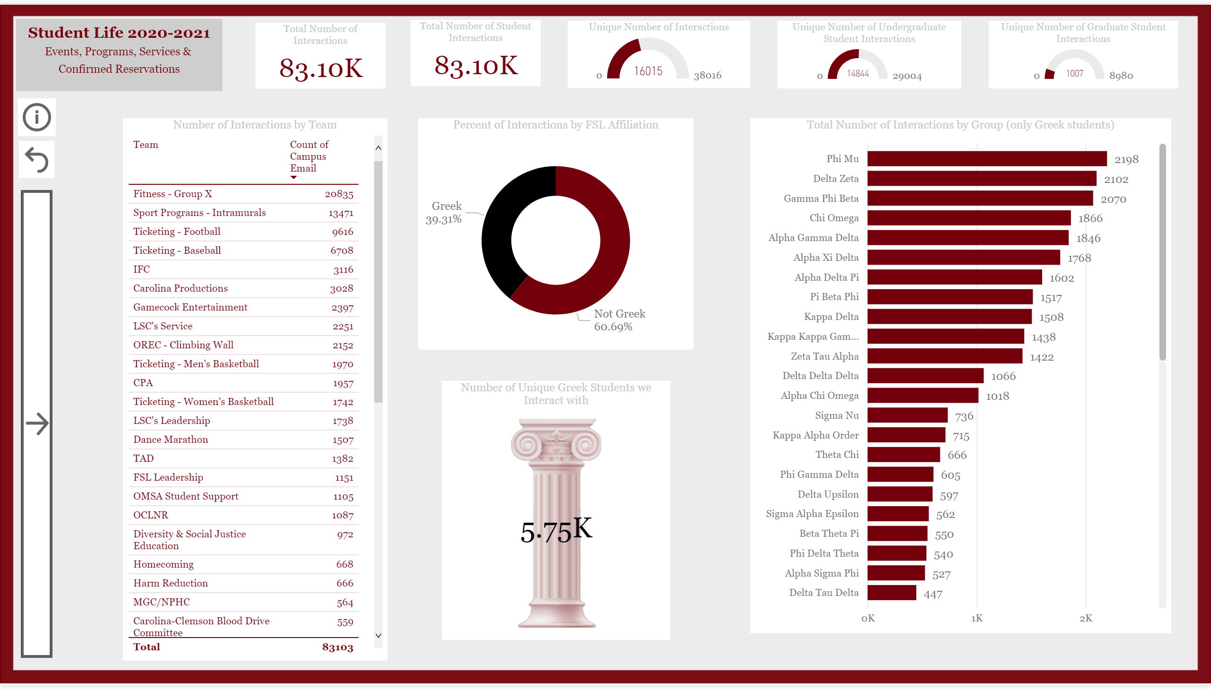
Greek Affiliation
Notes:
textbox
No alt text provided.
actionButton
No alt text provided.
actionButton
No alt text provided.
actionButton
No alt text provided.
actionButton
No alt text provided.
image
No alt text provided.
image
No alt text provided.
image
No alt text provided.
textbox
No alt text provided.
textbox
No alt text provided.
textbox
No alt text provided.
actionButton
No alt text provided.
textbox
No alt text provided.
actionButton
No alt text provided.
actionButton
No alt text provided.
ChicletSlicer1448559807354
No alt text provided.
Total Number of Interactions
No alt text provided.
Total Number of Student Interactions
No alt text provided.
Unique Number of Undergraduate Student Interactions
No alt text provided.
Unique Number of Interactions
No alt text provided.
Unique Number of Graduate Student Interactions
No alt text provided.
Number of Interactions by Team
No alt text provided.
Percent of Interactions by FSL Affiliation
No alt text provided.
Total Number of Interactions by Group (only Greek students)
No alt text provided.
Number of Unique Greek Students we Interact with
No alt text provided.
ChicletSlicer1448559807354
No alt text provided.
ChicletSlicer1448559807354
No alt text provided.
ChicletSlicer1448559807354
No alt text provided.
ChicletSlicer1448559807354
No alt text provided.
ChicletSlicer1448559807354
No alt text provided.

Slide 11
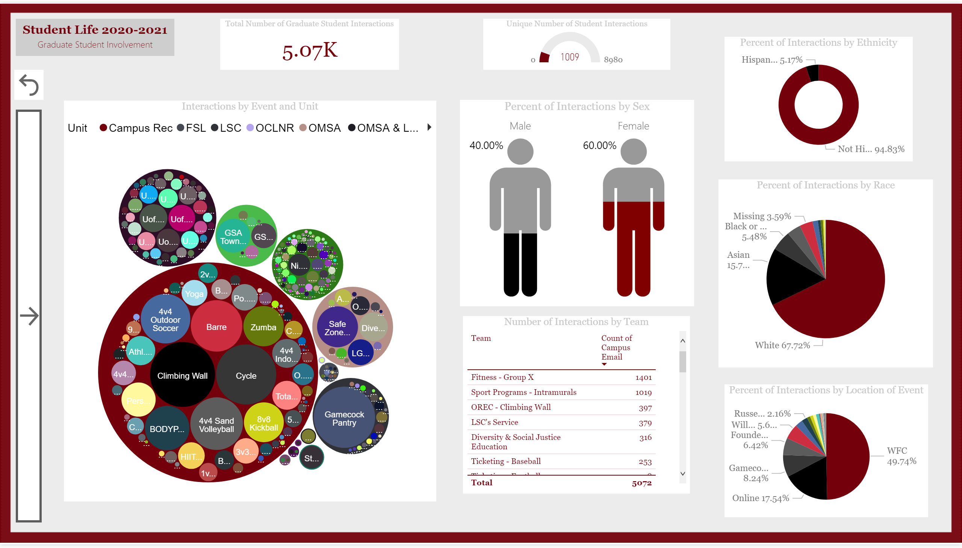
Graduate Students
Notes:
textbox
No alt text provided.
actionButton
No alt text provided.
actionButton
No alt text provided.
actionButton
No alt text provided.
actionButton
No alt text provided.
textbox
No alt text provided.
actionButton
No alt text provided.
actionButton
No alt text provided.
ChicletSlicer1448559807354
No alt text provided.
ChicletSlicer1448559807354
No alt text provided.
ChicletSlicer1448559807354
No alt text provided.
ChicletSlicer1448559807354
No alt text provided.
Percent of Interactions by Sex
No alt text provided.
Unique Number of Student Interactions
No alt text provided.
Percent of Interactions by Ethnicity
No alt text provided.
Percent of Interactions by Location of Event
No alt text provided.
Percent of Interactions by Race
No alt text provided.
Total Number of Graduate Student Interactions
No alt text provided.
Number of Interactions by Team
No alt text provided.
Interactions by Event and Unit
No alt text provided.

Slide 12
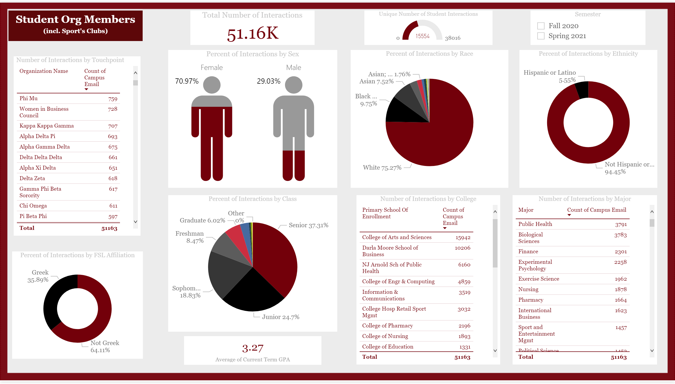
Student Org Members
Notes:
textbox
No alt text provided.
Semester
No alt text provided.
card
No alt text provided.
Percent of Interactions by Sex
No alt text provided.
Number of Interactions by College
No alt text provided.
Number of Interactions by Major
No alt text provided.
Percent of Interactions by FSL Affiliation
No alt text provided.
Percent of Interactions by Class
No alt text provided.
Total Number of Interactions
No alt text provided.
Unique Number of Student Interactions
No alt text provided.
Number of Interactions by Touchpoint
No alt text provided.
Percent of Interactions by Race
No alt text provided.
Percent of Interactions by Ethnicity
No alt text provided.

Slide 13
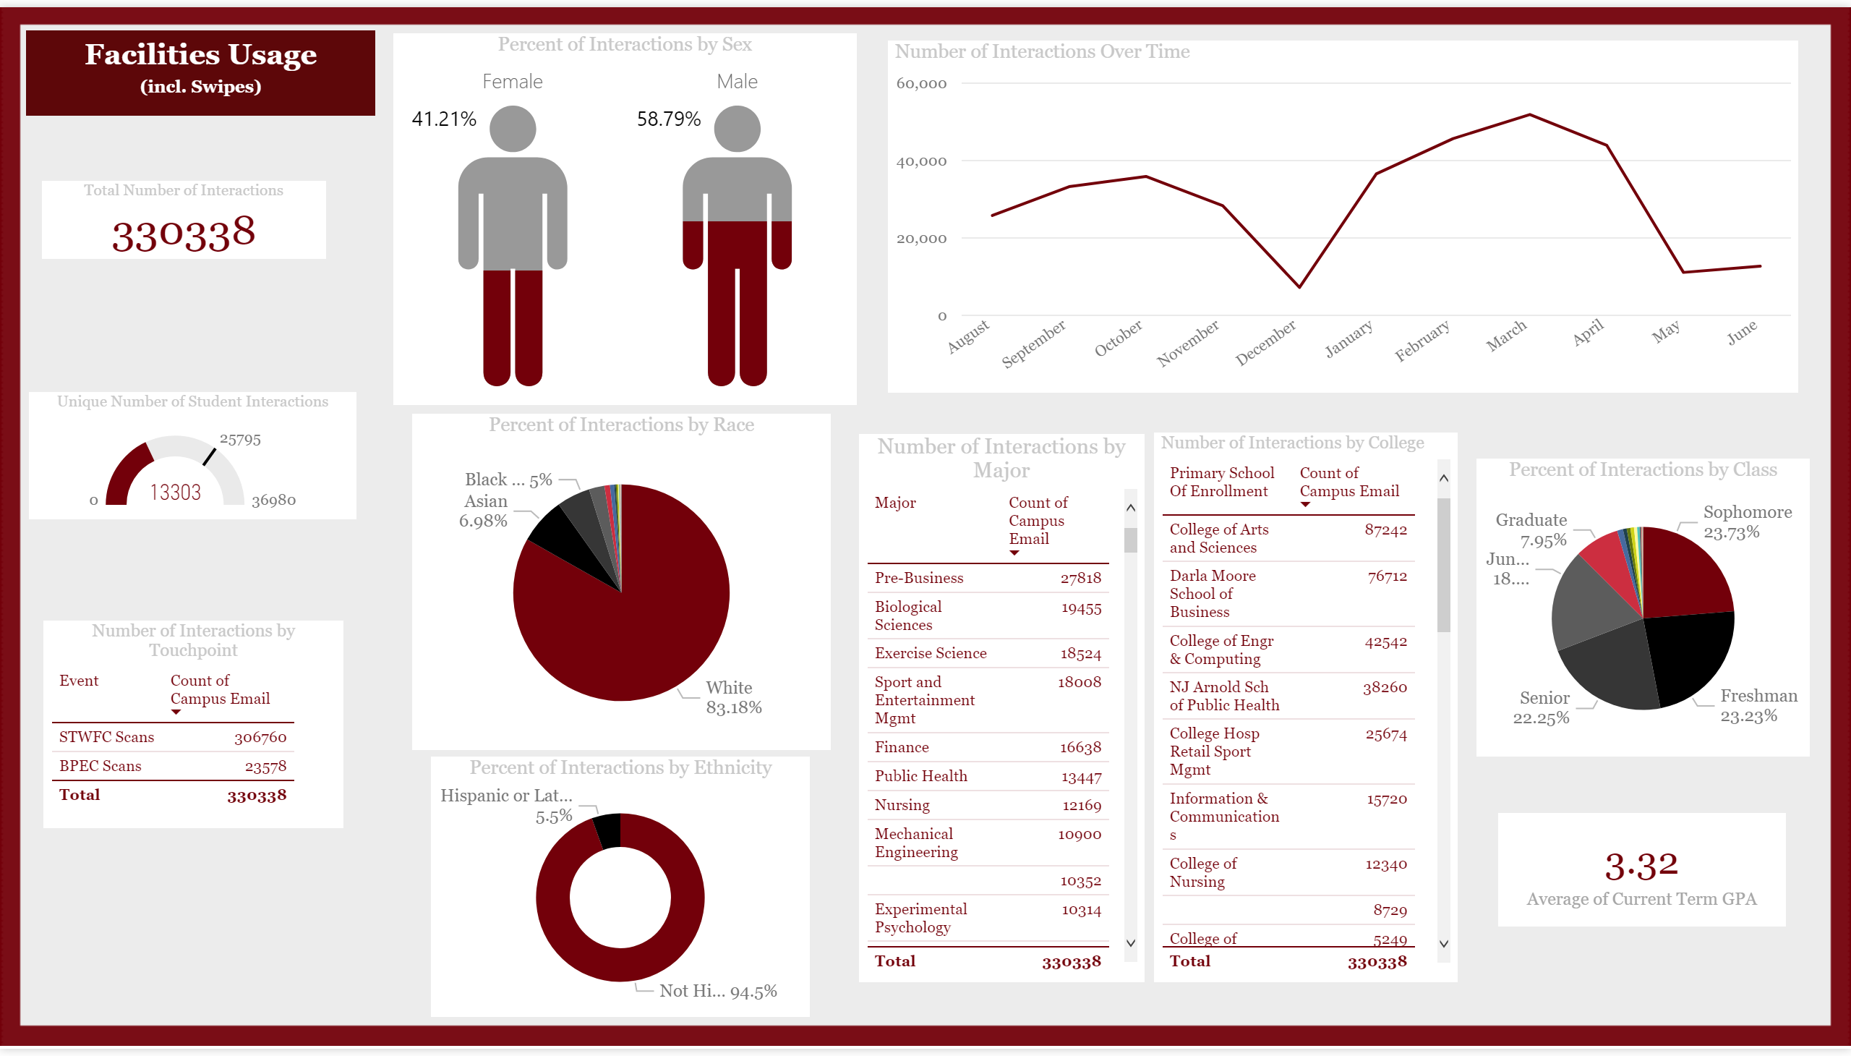
Facilities Usage
Notes:
textbox
No alt text provided.
Number of Interactions Over Time
No alt text provided.
Number of Interactions by College
No alt text provided.
Percent of Interactions by Class
No alt text provided.
Percent of Interactions by Race
No alt text provided.
Percent of Interactions by Ethnicity
No alt text provided.
card
No alt text provided.
Unique Number of Student Interactions
No alt text provided.
Number of Interactions by Touchpoint
No alt text provided.
Total Number of Interactions
No alt text provided.
Percent of Interactions by Sex
No alt text provided.
Number of Interactions by Major
No alt text provided.

